Slide 1
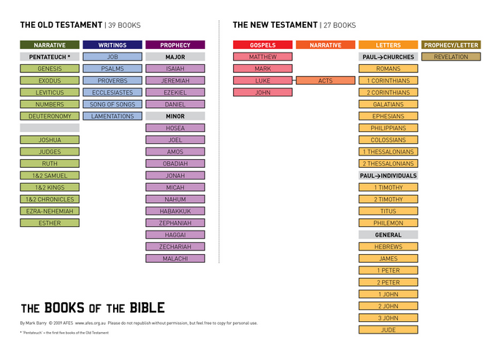
Basic Outline for “Seeing” the Bible
Creation
Covenant
Conquest
‘C’ingdom
Collapse/Restoration
Christ
Church
Culmination

Slide 2
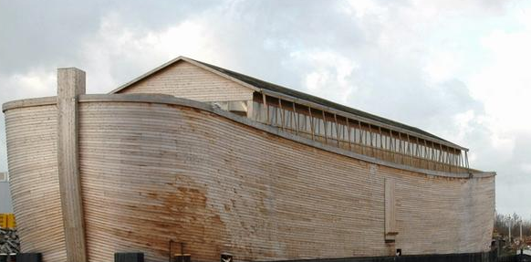
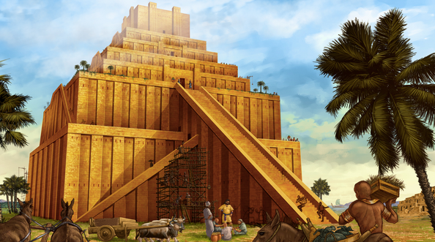
1. Creation
Creation
The Fall
The Flood
Tower of Babel
Key Idea: Man’s Rebellion
But God promised Messiah as early as Genesis 3:15: “And I will put enmity between you and the woman, and between your offspring (the serpent) and hers; he will crush your head, and you will strike his heel.”

Slide 3
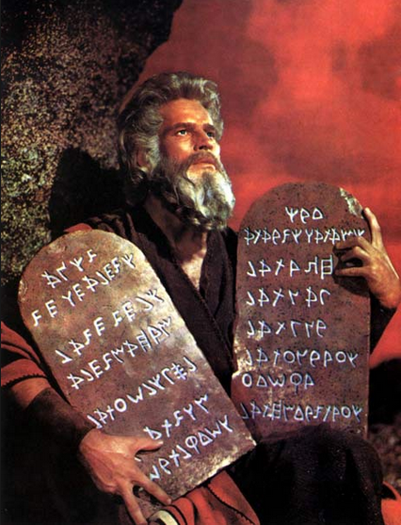
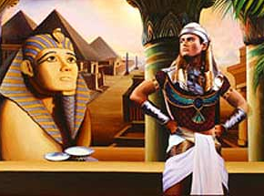
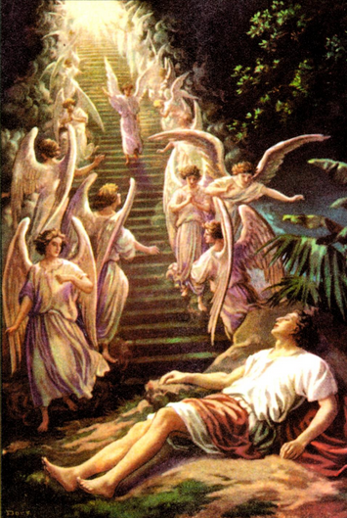
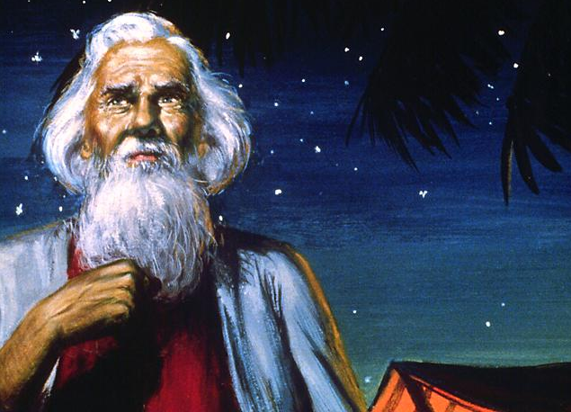
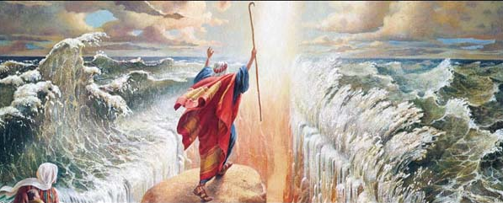
2. Covenant
Key Events
Abraham / Isaac / Jacob
Brothers sell Joseph into Egypt
Slaves for 400 years
Moses delivers people (plagues)
God gives Law
The Tabernacle
Genesis 12:1–3: The Lord had said to Abram, “Leave your country, your people and your father’s household and go to the land I will show you. “I will make you into a great nation and I will bless you; I will make your name great, and you will be a blessing. I will bless those who bless you, and whoever curses you I will curse; and all peoples on earth will be blessed through you.”

Slide 4
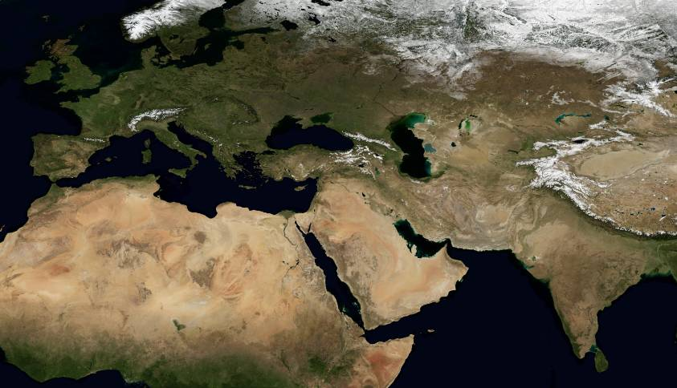
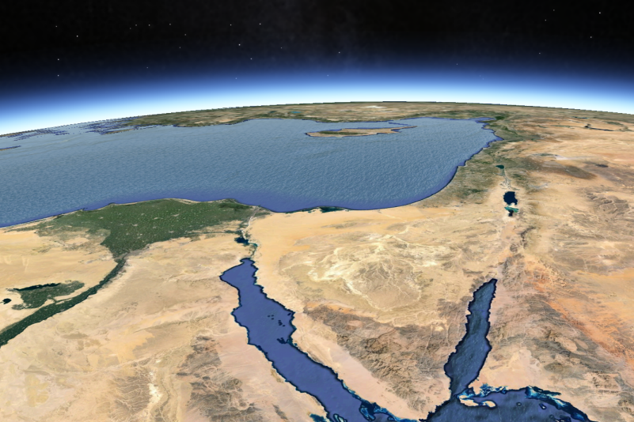
3. Conquest
Deuteronomy 1:6–8: The Lord our God said to us at Horeb, “You have stayed long enough at this mountain. Break camp and advance into the hill country of the Amorites; go to all the neighboring peoples in the Arabah, in the mountains, in the western foothills, in the Negev and along the coast, to the land of the Canaanites and to Lebanon, as far as the great river, the Euphrates. See, I have given you this land. Go in and take possession of the land that the Lord swore he would give to your fathers—to Abraham, Isaac and Jacob—and to their descendants after them.”
Key Events
Spies spy out land
People don’t believe
40 years of wandering
Joshua leads new generation in
Various judges (leaders)

Slide 5
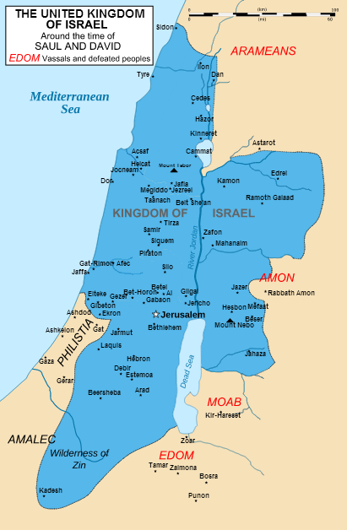
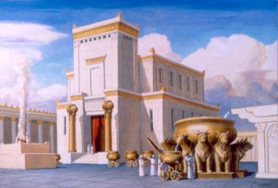
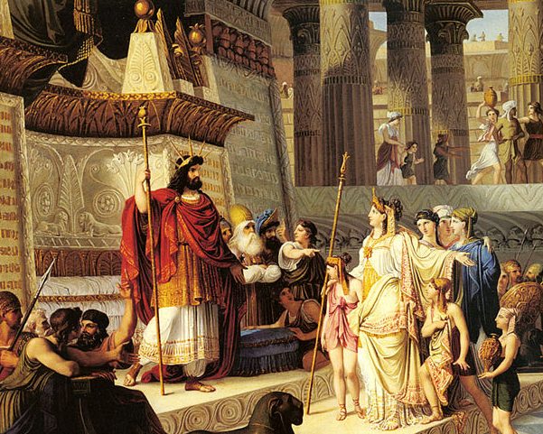
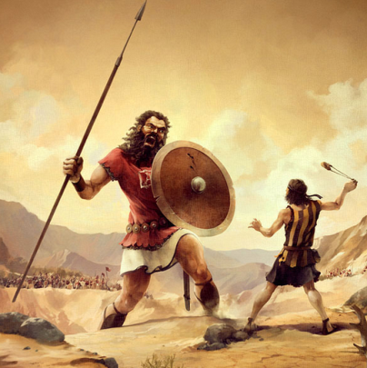
4. ‘C’ingdom
Key Events
King Saul’s unfaithfulness
Rise of David
David / Bathsheba
Solomon
The Temple
Kingdom splits
1 Samuel 8:4–7: So all the elders of Israel gathered together and came to Samuel at Ramah. They said to him, “You are old, and your sons do not walk in your ways; now appoint a king to lead us, such as all the other nations have.” But when they said, “Give us a king to lead us,” this displeased Samuel; so he prayed to the Lord. And the Lord told him: “Listen to all that the people are saying to you; it is not you they have rejected, but they have rejected me as their king.
Judah had 20 kings—12 were evil, 8 were good Israel had 19 kings—ALL were evil
Kings of Judah
Rehoboam | 933–916
Abijah | 915–913
Asa | 912–872
Jehoshaphat | 874–850
Jehoram | 850–843
Ahaziah | 843
Athaliah | 843–837
Joash | 843–803
Amaziah | 803–775
Uzziah | 787–735
Jotham | 749–734
Ahaz | 741–726
Hezekiah | 726–697
Manasseh | 697–642
Amon | 641–640
Josiah | 639–608
Jehoahaz | 608
Jehoiakim | 608–597
Jehoiachin | 597
Zedekiah | 597–586
Kings of Israel
Jeroboam | 933–911
Nadab | 911–910
Baasha | 910–887
Elah | 887–886
Zimri | 886
Omri | 886–875
Ahab | 875–854
Ahaziah | 855–854
Joram | 854–843
Jehu | 843–816
Jehoahaz | 820–804
Joash | 806–790
Jeroboam II | 790–749
Zechariah | 748
Shallum | 748
Menahem | 748–738
Pekahiah | 738–736
Pekah | 748–730
Hoshea | 730–721

Slide 6
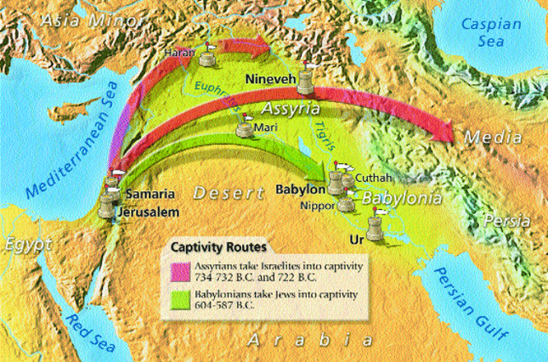
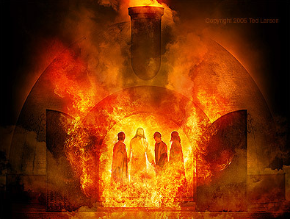
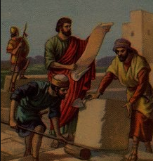
5. Collapse / Restoration
Jeremiah 25:8-9,11: Therefore the Lord Almighty says this: “Because you have not listened to my words, I will summon all the peoples of the north and my servant Nebuchadnezzar king of Babylon,” declares the Lord, “and I will bring them against this land and its inhabitants and against all the surrounding nations. I will completely destroy them and make them an object of horror and scorn, and an everlasting ruin… This whole country will become a desolate wasteland, and these nations will serve the king of Babylon seventy years.
Key Events
Prophets warn (Isaiah / Jeremiah)
Prophecies about messiah
Babylonian exile (Daniel / Lamentations / Esther)
Return to land (Ezra / Nehemiah)
Jeremiah 29:10–11: This is what the Lord says: “When seventy years are completed for Babylon, I will come to you and fulfill my gracious promise to bring you back to this place. For I know the plans I have for you,” declares the Lord, “plans to prosper you and not to harm you, plans to give you hope and a future.
Isaiah 9:6–7a: For to us a child is born, to us a son is given, and the government will be on his shoulders. And he will be called Wonderful Counselor, Mighty God, Everlasting Father, Prince of Peace. Of the increase of his government and peace there will be no end. He will reign on David’s throne and over his kingdom, establishing and upholding it with justice and righteousness from that time on and forever.
Notes:
5 prophets actually prophesied of Israel’s exile
Moses Moses warned the people of Israel that they would be delivered into the hands of their enemies if they did not keep the Sabbaths of the Lord (Deuteronomy 28:49,64; 29:28; Leviticus 25:5-6). Micah Micah, a contemporary of the prophet Isaiah, proclaimed in Micah 4:10 the capture of Israel by Babylon as well as their rescue. Habakkuk Habakkuk in Habakkuk 1:12-17 could not understand how God could use the godless Babylonians to discipline his own people. Jeremiah Jeremiah prophesied 23 years to his people to no avail. His own people beat him, put him in stocks, threw him down a cistern, placed him in jail; they did everything to Jeremiah except to listen to what the Lord was warning through his messenger. Jeremiah lived to see the fulfilment of his own prophecies in Jeremiah 20, 25 and 27, and also those of other prophets of God. Jeremiah obeyed the Lord despite the brutal and adverse reaction he received from his own people. King Zedekiah had the choice to listen to the Lord’s warnings, have remorse, repent and to lead Israel back to the Lord. Unfortunately he preferred to listen to the false prophets and he paid dearly for that. Jeremiah prophesied the period of 70 years of captivity in Jeremiah 25:8-14 andJeremiah 29:10-14. Three deportations are summarized in Jeremiah 52:28-30: • 3,023 Jews were carried into exile with the first deportation. • 745 Jews were taken into exile with the second deportation. • 4,600 people were taken captive with the third and final deportation. Isaiah Years ago when King Hezekiah ruled, messengers from Babylon came to visit him. He was very proud of Israel and King Hezekiah showed them everything, all the treasures of the land. When Isaiah heard about this, he prophesied in Isaiah 39:5-8that everything King Hezekiah so proudly displayed to the Babylonians would be taken away by them along with his countrymen. Isaiah prophesied the capture of Daniel. Isaiah prophesied about Cyrus the Persian in Isaiah 44:28-45:4 more than 100 years before Cyrus was born. Isaiah proclaimed the fall of Babylon in Isaiah 13:1-14; 21:1-17 and 33:1-35.

Slide 7
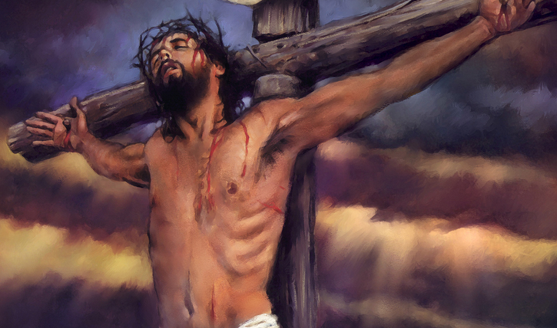
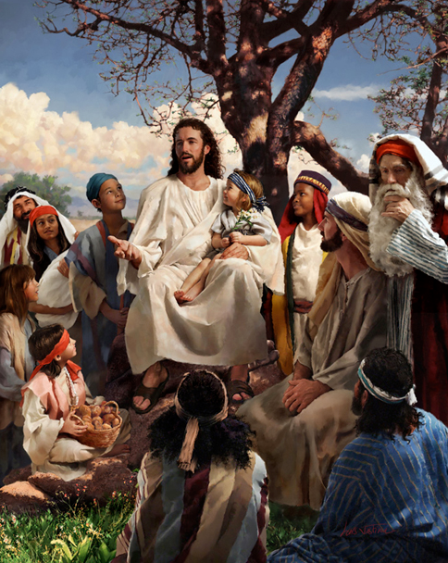
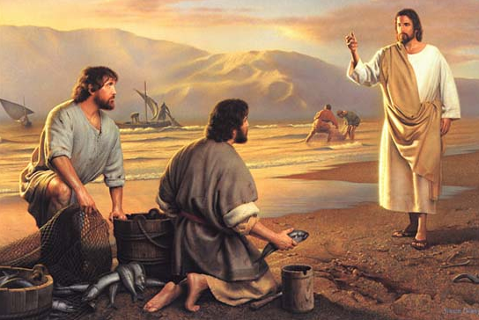
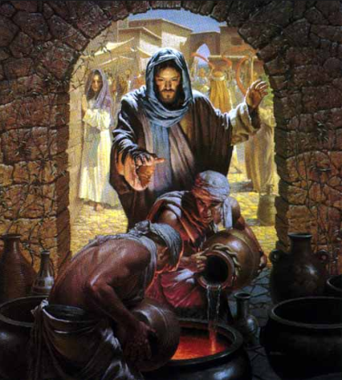
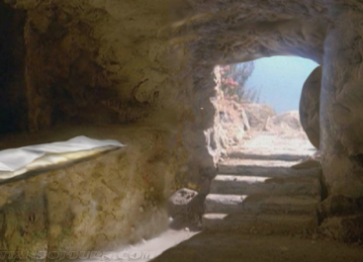
6. Christ
Key Events
Jesus’ sinless life
Death, burial resurrection
Raising up of apostles
Mark 1:1: The beginning of the gospel (good news) about Jesus Christ, the Son of God...
John 3:16: “For God so loved the world that he gave his one and only Son, that whoever believes in him shall not perish but have eternal life.
John 4:26: Then Jesus declared, “I who speak to you am he.”
John 20:31: But these are written that you may believe that Jesus is the Christ, the Son of God, and that by believing you may have life in his name.

Slide 8
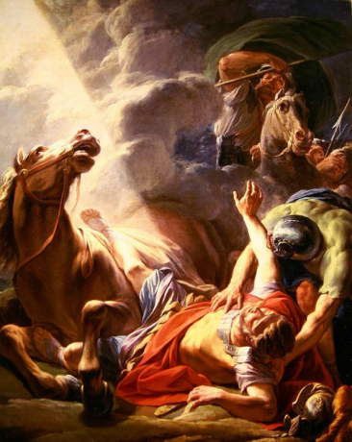
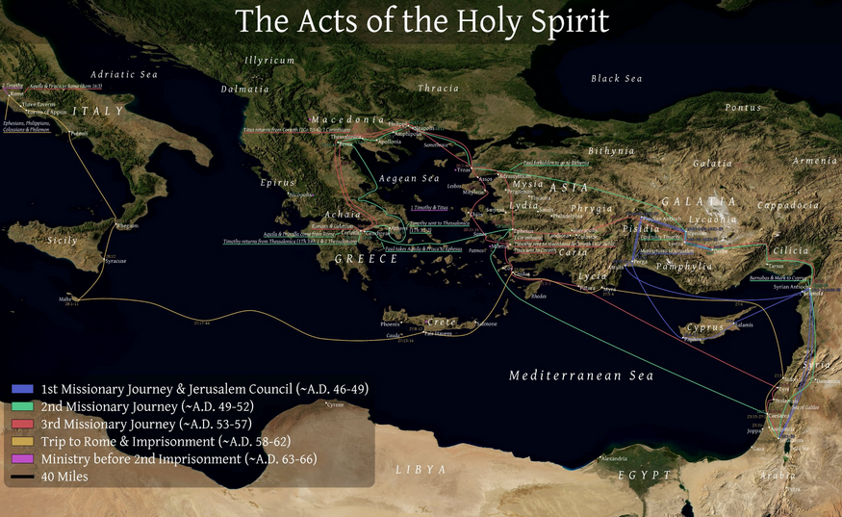
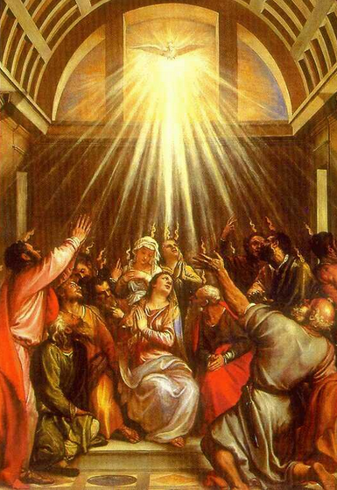
7. Church
Key Events
Pentecost / giving of Holy Spirit
How the church started (Acts)
Apostles explain gospel (letters)
Acts 1:8: But you will receive power when the Holy Spirit comes on you; and you will be my witnesses in Jerusalem, and in all Judea and Samaria, and to the ends of the earth.”

Slide 9
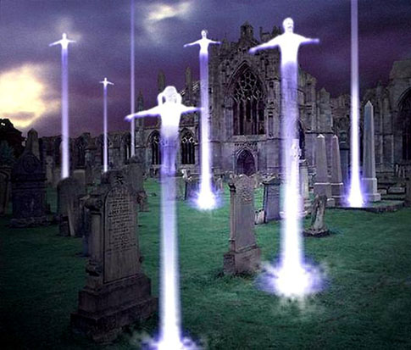
8. Culmination
Key Events
Rapture
Tribulation Period / Antichrist
Second Coming
Millennial Kingdom
White Throne Judgment
New Heaven & Earth
2 Thessalonians 2:3–4: the man of lawlessness… will oppose and will exalt himself over everything that is called God or is worshiped, so that he sets himself up in God’s temple, proclaiming himself to be God.
Revelation 13:17a: no one could buy or sell unless he had the mark...
Revelation 20:4d: They came to life and reigned with Christ a thousand years.
Revelation 21:1: Then I saw a new heaven and a new earth, for the first heaven and the first earth had passed away, and there was no longer any sea.
YOU ARE HERE

