Slide 2
How to
Hack your
Faith
Modern ideas to “walk in the Spirit and you shall not fulfill the lusts of the flesh.” (Galatians 5:16)

Slide 3
www.geekychristian.com
WHY WE EXIST
TO SHARE JESUS TO A DISTRACTED WORLD
AND GROW CLOSER TO GOD THRU TECHNOLOGY
What do we mean share Jesus to a “distracted world?”

Slide 4
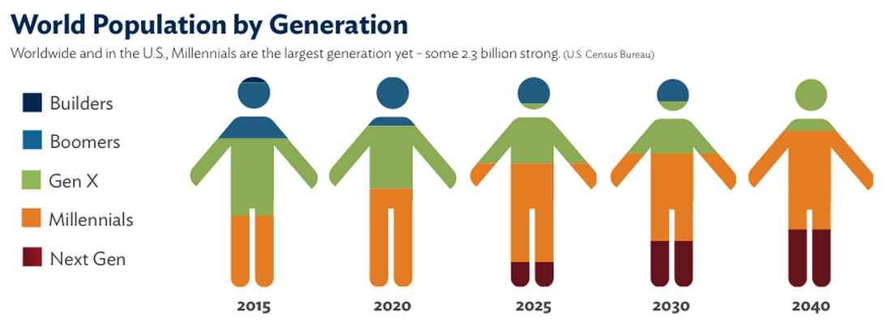
MILLENIALS 1977-1996
Generation Y

Slide 5
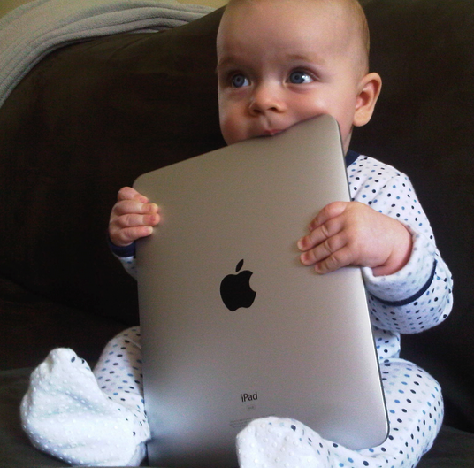
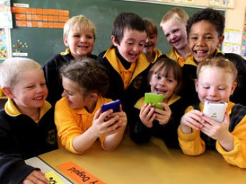
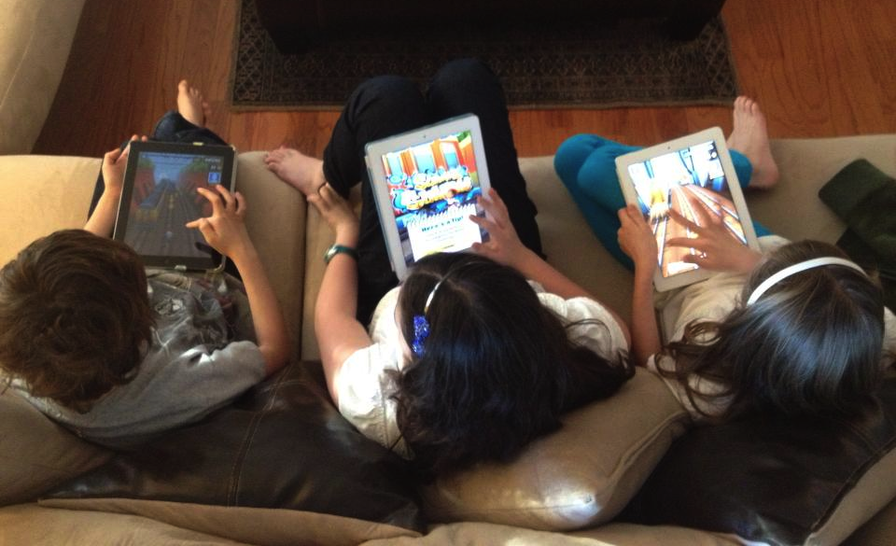
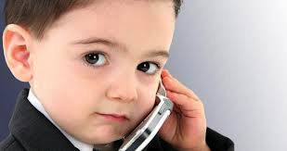
iGENERATION 1997-NOW
Generation Z
Net Generation?
Scholars Generation?
Pluralist Generation?

Slide 6
BREAKDOWN
The Good
The Challenges
Nice
Positive / optimistic
Craves authenticity
Accepting of differences
Pragmatic idealists
Tech savvy
Life hackers / tinkerers
New experiences more important than material things
Able to absorb a lot of info in short bursts
70% check phone every hour
Narcissistic
Sense of entitlement
Most social interaction done through a screen
Postpones big decisions
Avoids responsibility
Rejects (suspicious of) authority
Believes in God but doesn’t go to church because don't identify with big institutions
70% check phone every hour

Slide 7
DIGITAL POPULATION
August 2013
Facebook 1.15 billion
Google+ 343 million active users
Instagram 130 million active users
Reddit 69.9 million active users
SlideShare 50 million users
Pinterest 70 million users
Vine 13 million users
Tumblr 216.3 monthly visitors; 108.9 million blogs
Twitter 500 million total users; 200 million active
People in 33AD 200-300 million
“Go therefore and make disciples of all nations!” (Matthew 28:19)
“You will be my witnesses in Jerusalem, and in all Judea and Samaria, and to the ends of the earth.” (Acts 1:8b)

Slide 8
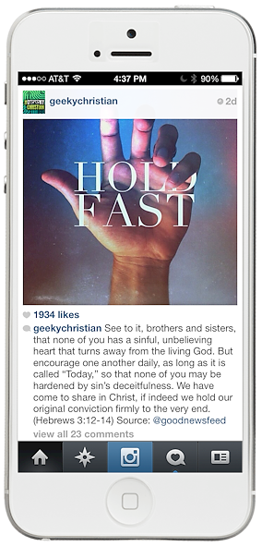
INJECT GOSPEL BITS
Going into all the world
122k followers Facebook • 34k Instagram • 3k Tumblr
55k Philippines • 21k India • 5k Pakistan • 2k Egypt

Slide 9
WHY WE EXIST
TO SHARE JESUS TO A DISTRACTED WORLD
AND GROW CLOSER TO GOD THRU TECHNOLOGY
How do we use tech to grow closer to God?

Slide 10
CHRISTIAN GROWTH
Jesus Gave Two Keys
Holy Spirit (John 14:16,18) “And I will pray the Father, and He will give you another Helper, that He may abide with you forever—the Spirit of truth… I will not leave you orphans; I will come to you.”
Abiding (John 15:1-8) “Abide in Me, and I in you. As the branch cannot bear fruit of itself, unless it abides in the vine, neither can you, unless you abide in Me.”
Galatians 5:16 “So I say, walk by the Spirit, and you will not gratify the desires of the flesh.”

Slide 11
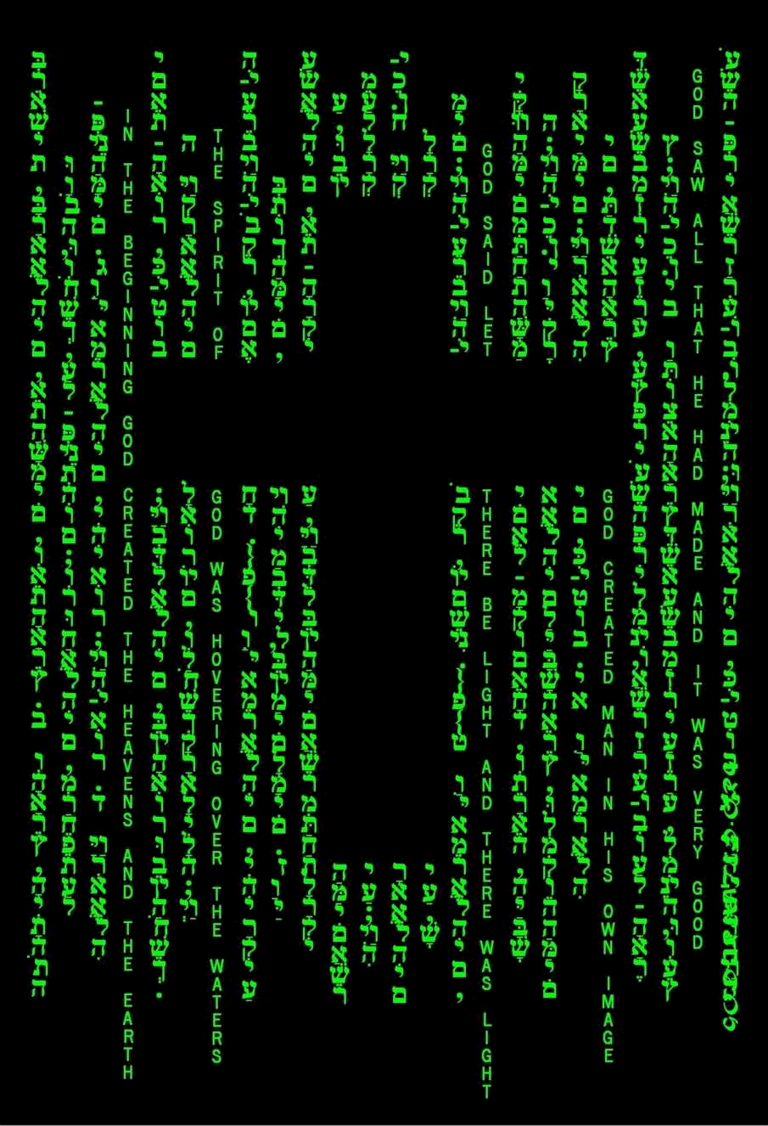
CHRISTIAN GROWTH
Abiding thru technology
life·hack
A tip, trick, hack or shortcut to improve an everyday task.
We’ve seen technology improve everything else.
It’s time to let it improve our Christian walk!

Slide 12
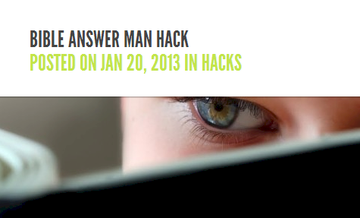
LIFE•HACKS
www.geekychristian.com

Slide 13
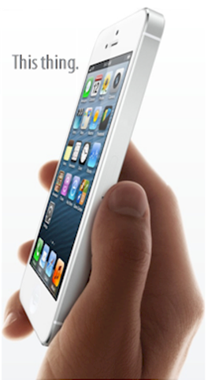
HUNGRY FOR THE BIBLE•HACK
“So then faith comes by hearing, and hearing by the word of God.” (Rom. 10:17)
STEP #1: GET A DEVICE.
iPhone / Smartphone
Always with you
Can stream even without WiFi
Can be pricey without contract
iPod Touch
Don’t require data plan
$75 to $100 used
Family member’s old phone
Tablets
iPad new/used/mini
Any new Android tablet
Amazon Kindle Fire

Slide 14
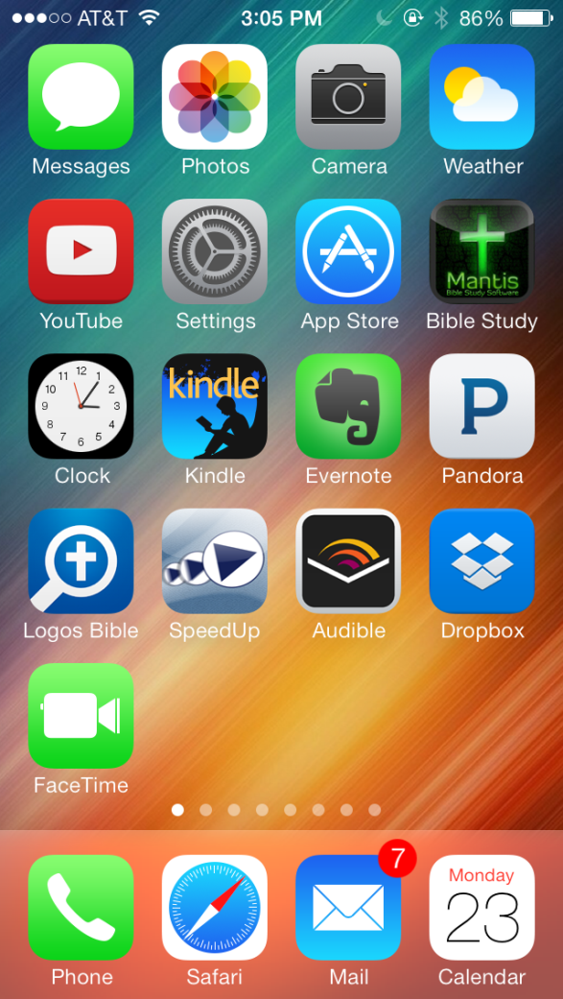
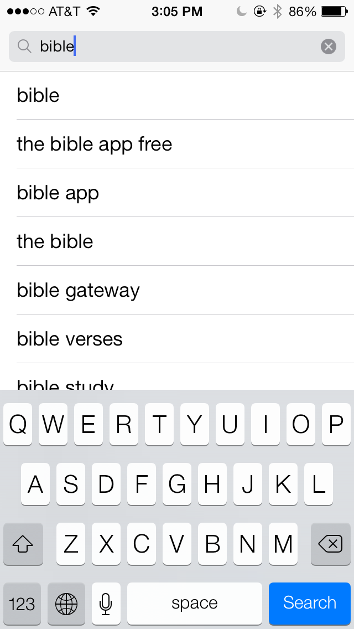
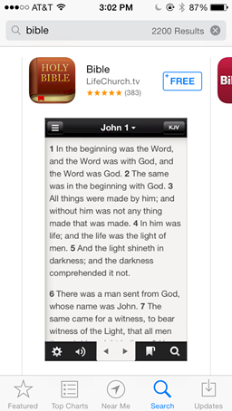
STEP #2: INSTALL THE FREE BIBLE APP.
1. Open App Store
2. Search for “Bible”
3. Click and install.

Slide 15
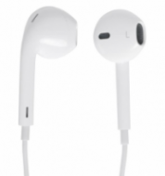
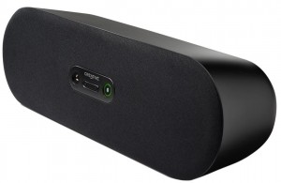
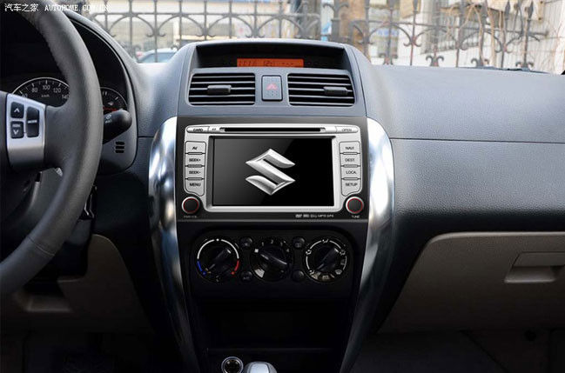
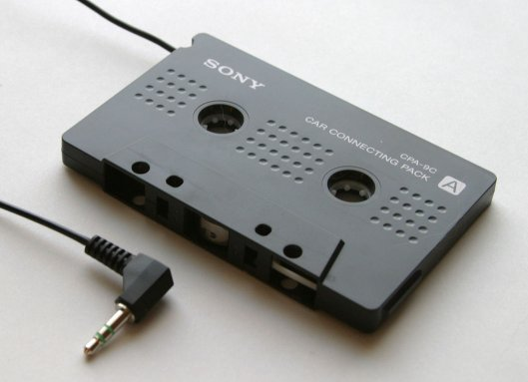
STEP #3: DECIDE HOW TO LISTEN
Ear Buds
Wireless Speaker
Bluetooth Earpiece
A2DP Car Stereo
Cassette Adapter

Slide 16
STEP #4: DECIDE WHERE TO START.
Most start at beginning: Gen → Ex → Lev → Num → and die at Deuteronomy
Might be better to get good understanding of New Testament first
Start in John → Acts → … Rev
Matt, Mark, Luke
Then OT

Slide 17
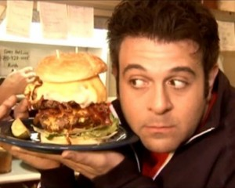
STEP #5: PLAN FOR MORE FREQUENT, SMALLER MEALS.
Set realistic goals
Not going to listen to 5 hours per day
Lots of smaller meals instead of one large meal a day
5 -10 minutes at a time
Pickup where you left off
Before bed, late at night, in car, shower!

Slide 18
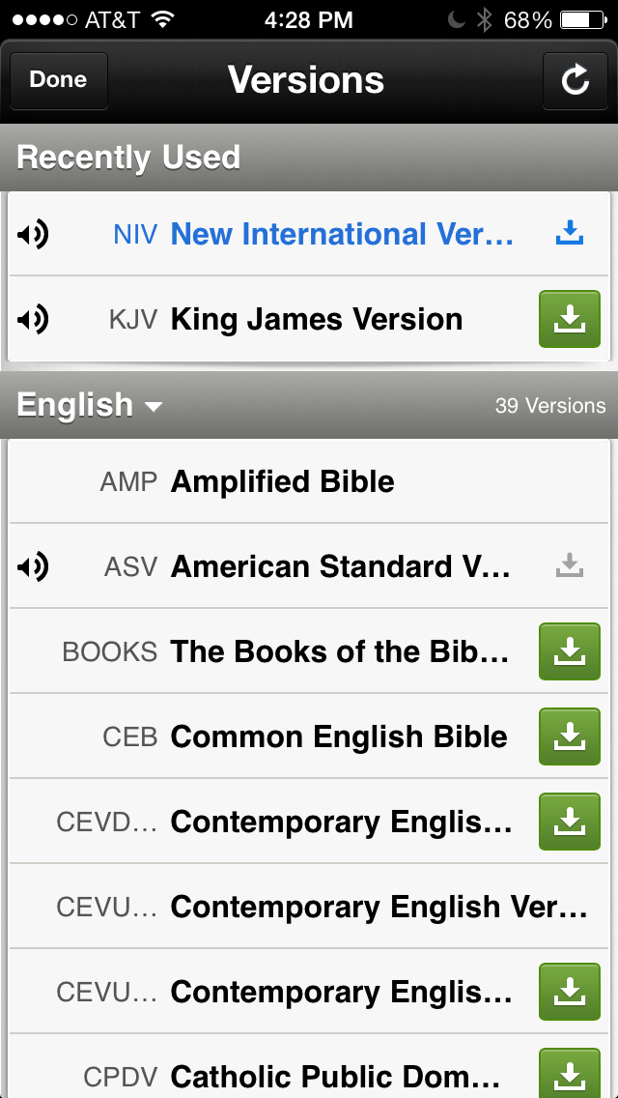
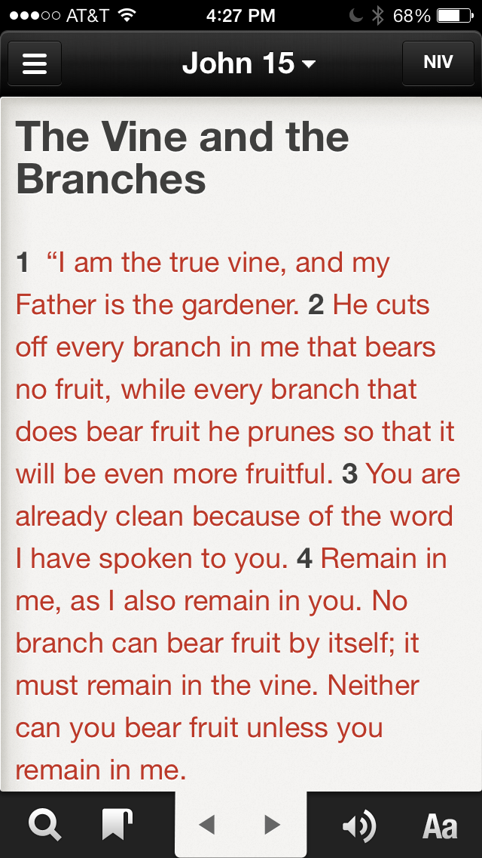
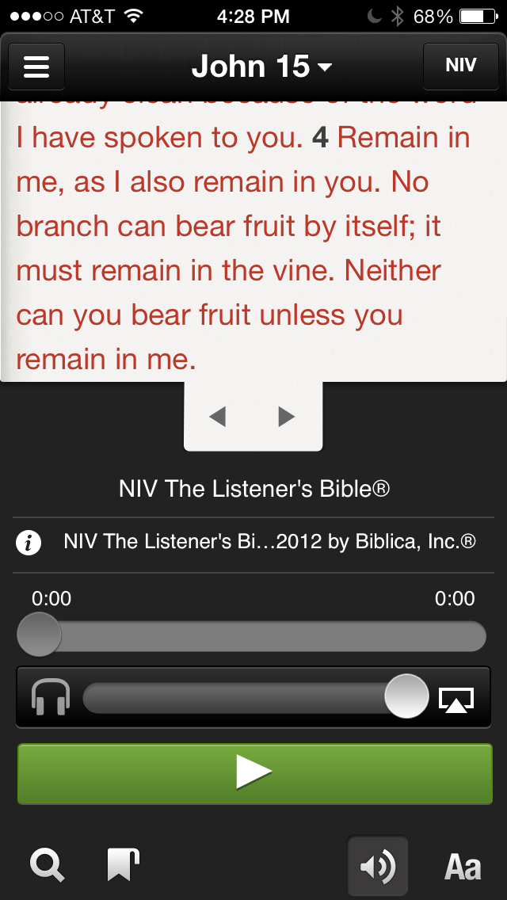
STEP #6: LISTEN. HERE’S HOW.
1. Select NIV
2. Click Speaker
3. Click Play
Audio by Max McLean
Audio Bible for $0.00! That’s it!

Slide 19
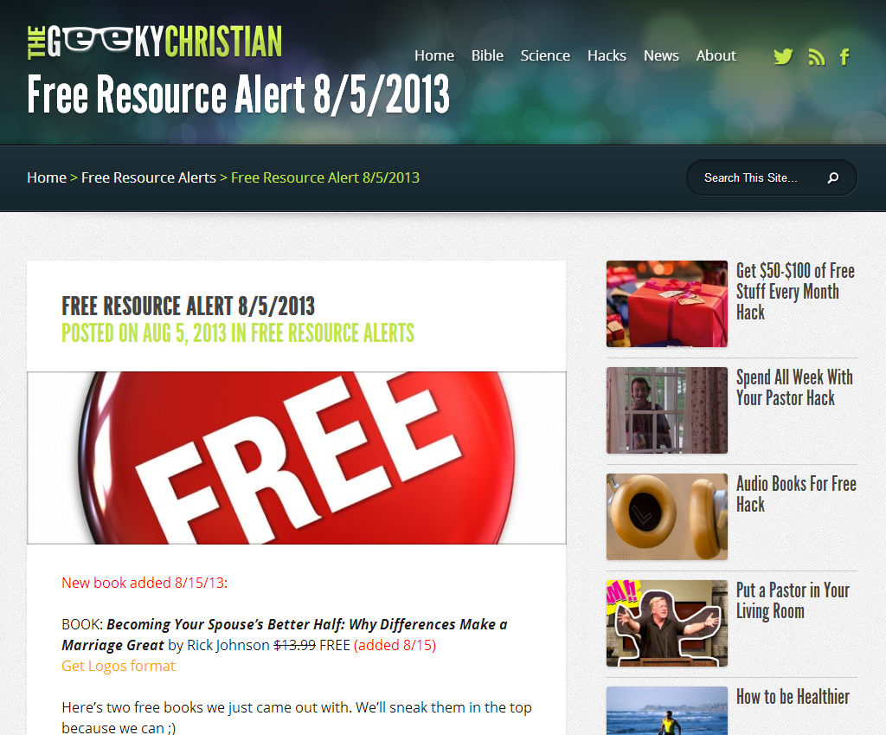
GET FREE STUFF•HACK
God has given us teachers
“And He Himself gave some to be apostles, some prophets, some evangelists, and some pastors and teachers, for the equipping of the saints for the work of ministry, for the edifying of the body of Christ... (Eph. 4:11-12)
Many of these pastors and teachers have written books!
Many of these books you can get for free!
Get $50 to $100 of free stuff every month!

Slide 20
GET FREE STUFF•HACK
Actual digital books (2-5 per month, $10-20 for free)

Slide 21
GET FREE STUFF•HACK
Actual audio books (1 per month, $13-$20 for free)
Some months we find over $100 of free stuff. That’s over $1,200 per year. What a great way to grow!
How…?

Slide 22
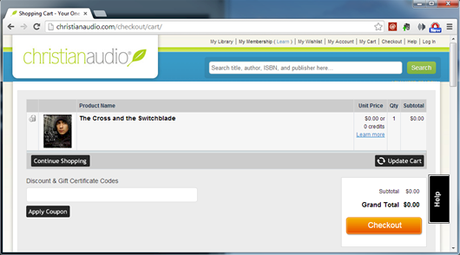
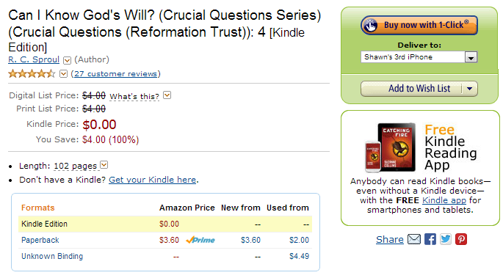
STEP #1. WANT IT.
Getting free stuff requires a little bit of effort on your part.
First time, you’ll need to create account with the store.
You’ll go through the motions of “buying” the product but the price will be $0.00. They may ask for a credit card. Don’t worry. As long as your cart says $0.00 they will not charge you.
Next, some of these stores require you to install apps to read their books (like the Amazon Kindle app or Logos reader).

Slide 23
STEP #2. FOLLOW US ON ANY SOCIAL NETWORK.
Instagram
Facebook
Tumblr
Twitter
Google+
Pinterest
We continually scour the Internet until we find a free product.
When we do, we notify our followers like this
→

Slide 24
STEP #3. WHEN WE ANNOUNCE, GRAB FAST.
Most are commercial products are promoted for free for 24-48 hours only.
You have to be quick. As soon as you see us announce them, jump on it.
If you wait even an hour you may find them asking $20 for that book that was $0.
And you will be very, very sad.
$50 to $100 to grow per month for $0.00! That’s it!
Also get 65+ audio books & 200+ digital books at www.geekychristian.com What a great way to grow!

Slide 25
NEXT WEEK
Free Bible college hack
Become a Bible answer man
Put a pastor in your living room.
www.geekychristian.com

